Slide 1
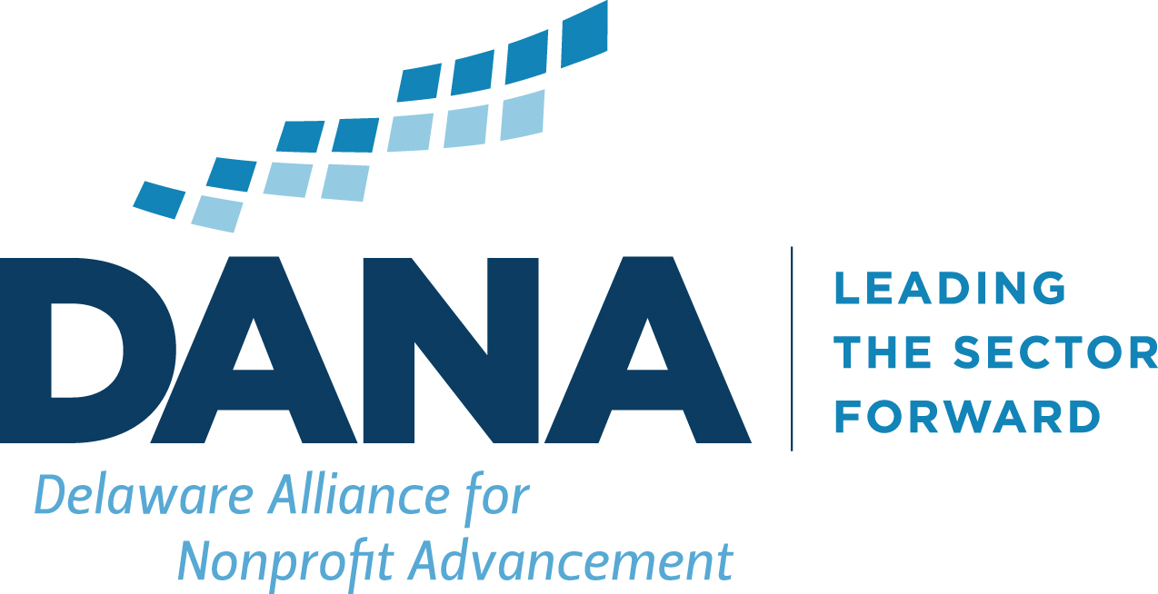

Scenario Modeling

Slide 2
Running Parallel Tracks
Crisis Management – Contingency Planning
Protect Mission
Protect Clients/Beneficiaries
Manage Cashflow
Adjust Operations
Survive!
In Partnership with
Future Planning and Scenario Modeling
Face Reality
Adjust to Changing Realities
Adapt the Organization
Develop the Strategy for future relevance and impact
Grow and Thrive
Two Tracks Executed Simultaneously!

Slide 3
Scenario Modeling
“Future Planning” translates into “Scenario Modeling” by
Identifying the resources needed to carry out a specific plan
Capturing the costs necessary to deploy those resources to execute that plan.
Identifying funding to support that plan and planning for variability in that funding.
Create Clarity and Adaptability!
In Partnership with

Slide 4
Scenario Modeling
A Disclaimer:
A scenario model is NOT a budget
  Its okay to estimate and use broader numbers if actuals are not known or easy to create.
  Don’t sweat the small stuff – a good scenario tells you how the BIG drivers affect your financial picture.
In Partnership with

Slide 5
Scenario Modeling
REVENUE:
Important aspect of Scenario Modeling is to capture uncertainty, both in scale and in impact.
Different Revenues have different uncertainties.
Fixed Revenues: Uncertainty is about Probability
  “Will we receive that grant?” | “Will we get our contract renewed?”
Variable Revenues: Uncertainty is about Variability
  “How much % decline can we expect from our earned income or fundraising income?”
In Partnership with

Slide 6
Scenario Modeling
Expense:
Pareto Principle:
  Know your 80%
Start by building your expense model to MEET THE NEED and then adjust based on revenue.
Make sure you are capturing FULL program costs and all uses of cash (some are not “expenses” from an accounting standpoint).
Identify the CORE
In Partnership with

Slide 7
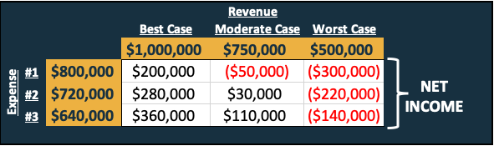
Scenario Modeling
Bring It All Together:
In Partnership with

Slide 8
Scenario Modeling
Bring It All Together:
Know your Assumptions
Know your Drivers
Create possible action steps and options
In Partnership with

Slide 9
Scenario Modeling
Action Steps/Options:
  “No Regret” Moves:
    Actions with positive benefits under any scenario
      Discretionary spending savings that don’t harm staff or programs
  Options/Hedges:
    Small scale, flexible moves that can be done quickly if a milestone is reached.
    Reduce management compensation by XX% if certain funding source doesn’t come in as planned.
  Major Activities/Cost Reductions
    New Programming or Shuttering Existing Programs
In Partnership with

Slide 10
Scenario Modeling
Identify WHEN to Act:
  Don’t wait until its too late
  Know how to act and when so that you can act quickly when the time comes
  Identify Trigger Points
    A certain Date
    A certain Event
  Get the whole leadership team on board with trigger points and action steps.
In Partnership with

Slide 11
Scenario Modeling
Keep it Current:
  Just like with cashflow, revisit the models as new information is received and keep the models current.
  Be willing to pivot with new information.
In Partnership with

Slide 12
Questions?
In Partnership with
Contact Delaware Alliance for Nonprofit Advancement:
essisell@delawarenonprofit.org
303-777-5500
delawarenonprofit.org

